Slide 1
BLOCKHOLE
ICG - 1st project
Ricardo Rodriguez - 98388
Available at https://ricardombrodriguez.github.io/Blockhole/

Slide 2
CONTENTS
Contents I will talk about during this presentation:
The idea
Models and the scene graph
Animation
Illumination and shadows
User interaction
Development
Conclusion

Slide 3
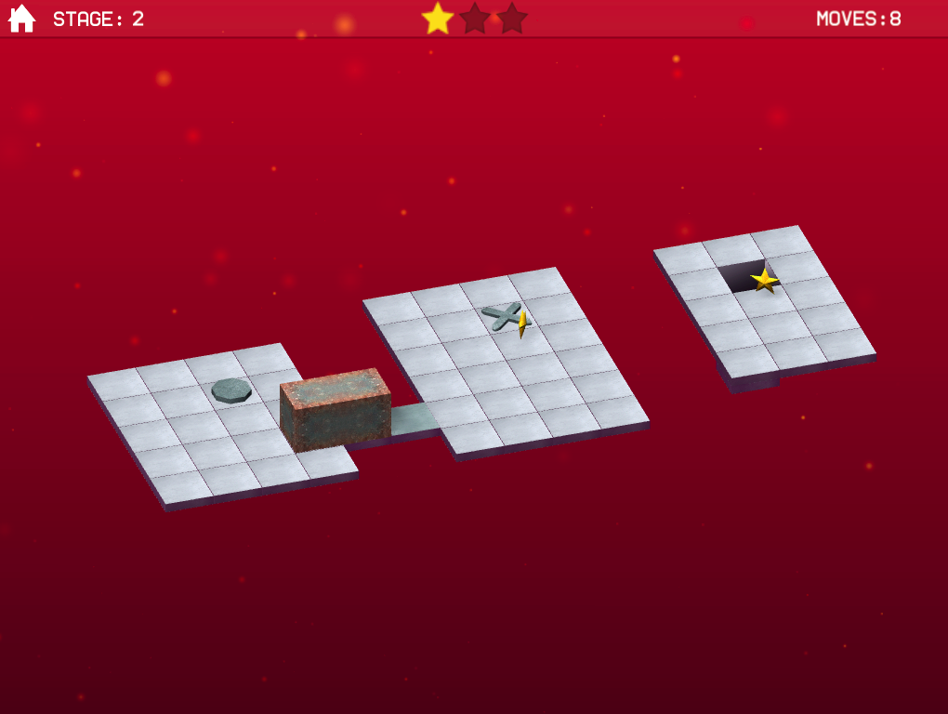
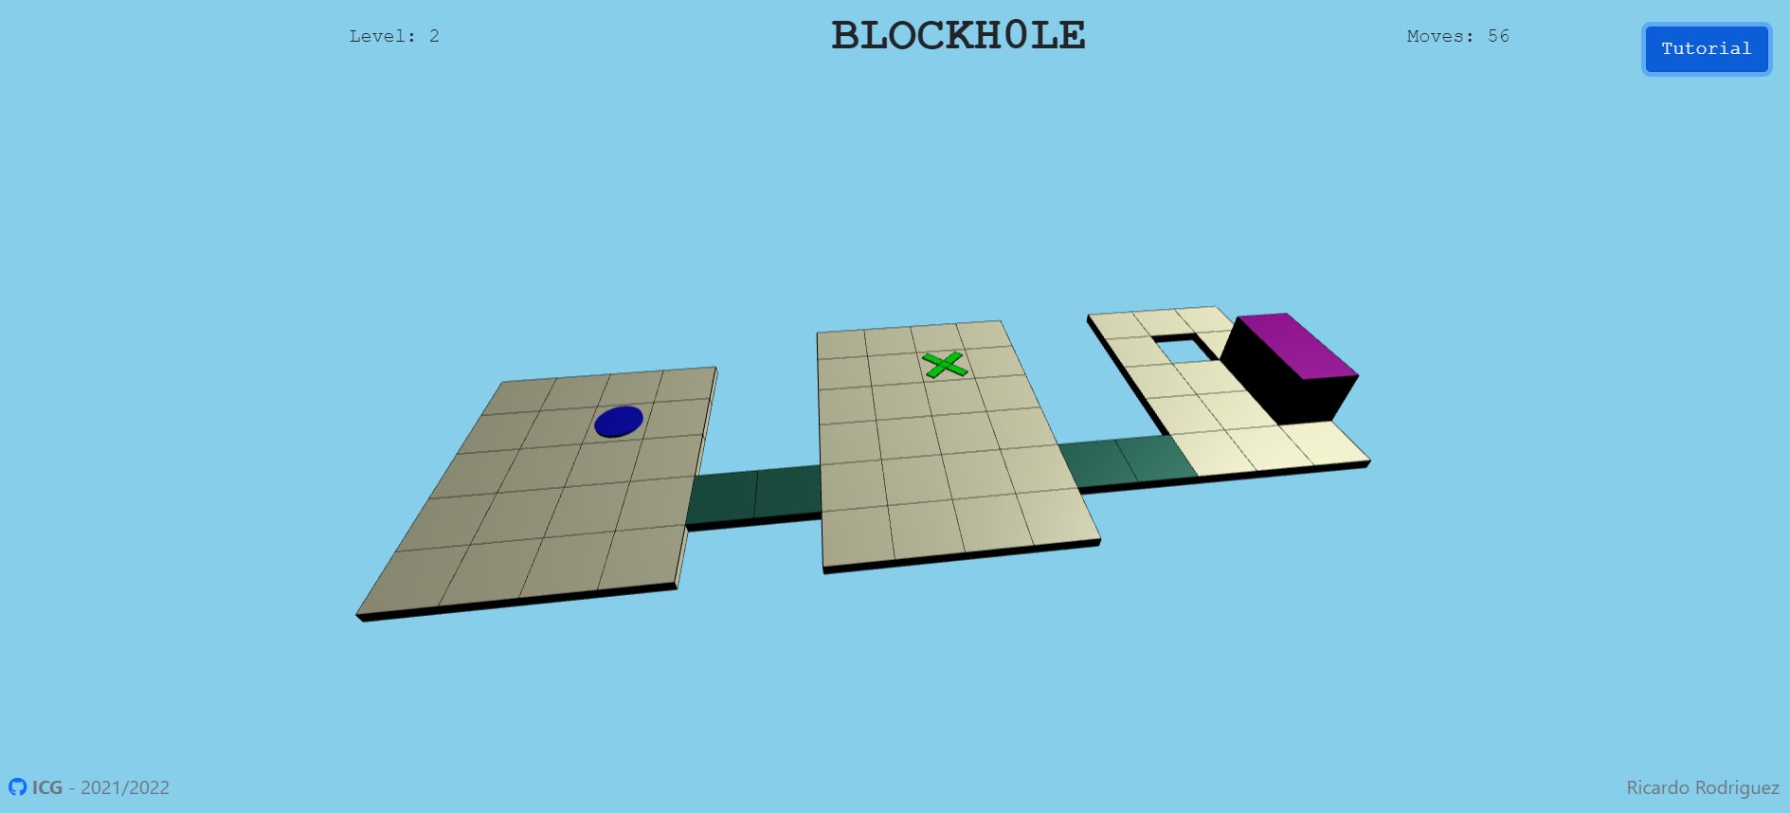
THE IDEA
Recreate Bloxorz, a popular game made by Miniclip.
Bringing back nostalgia to life..

Slide 4
THE IDEA
WHAT THE USER CAN DO
Manipulate the block in order to solve the puzzle, achieved when the block is aligned vertically with the hole
Trigger special tiles, allowing the appearance of new tiles
Avoid fragile tiles

Slide 5
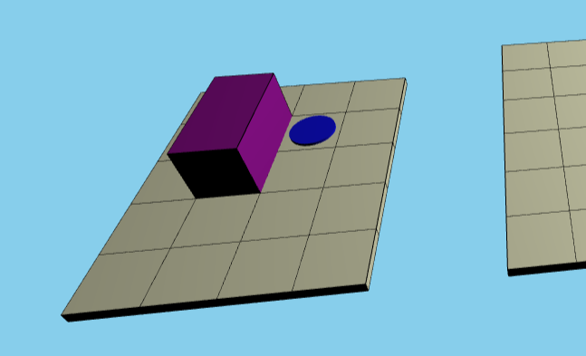
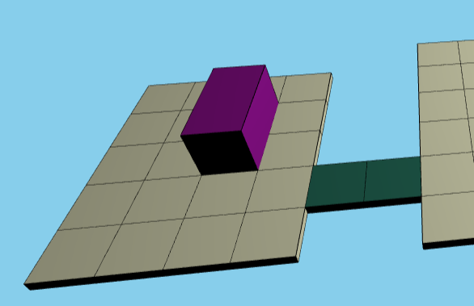
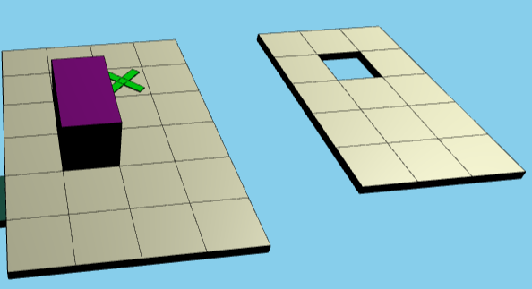
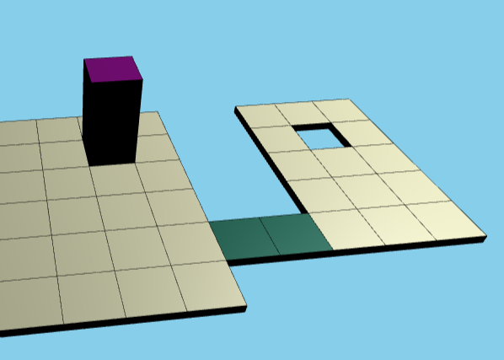
THE IDEA
NORMAL ACTIVATOR
VERTICAL ACTIVATOR
Triggered when the block is on top of it
Triggered only when the block is on top of it

Slide 6
MODELS AND SCENE
No external models
Game stats (level, moves, tutorial)
Scene:
Normal tile
Horizontal activator tile (“O” shape)
Vertical activator tile (“X” shape)
Fragile tile
Block
Camera (dynamic according to the level)

Slide 7
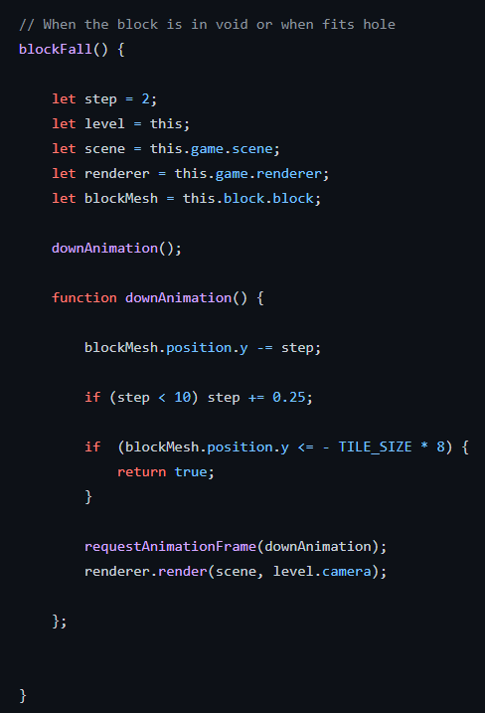
ANIMATIONS
Block animation when falling into the void (when passing the level or failing)
Fragile tile when block is completely on top of it (vertically)
Both of these animations have a bigger step each instant, simulating gravity

Slide 8
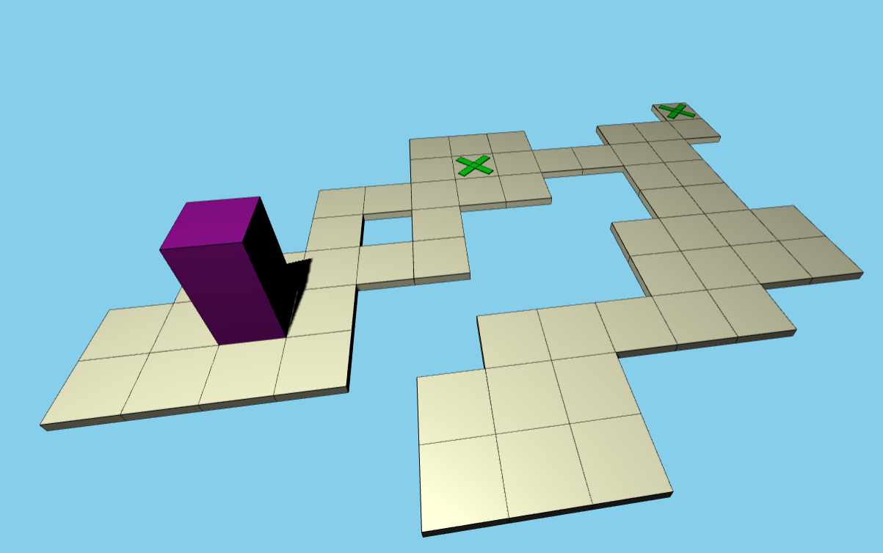
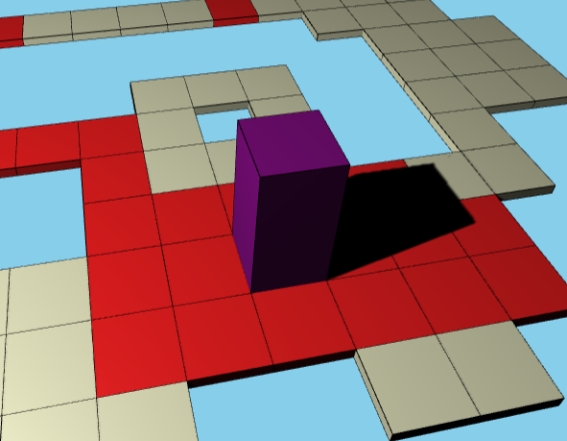
ILLUMINATION AND SHADOWS
Illumination: SpotLight with dynamic position, according to the current level.
Shadows: All board elements receive and cast high quality shadows (2048 mapSize instead of the default 512).

Slide 9
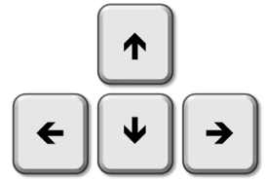
USER INTERACTION
User interaction is done by keyboard.
Allowed keys: PgUp, PgDown, PgLeft, PgRight. Commonly called “Arrow Keys”
Each one of them allows the manipulation of the block

Slide 10
DEVELOPMENT
Strategy: Create a class for each entity:
- Main (allows the creation of new Games)
- Game (constituted by Levels, has game stats)
- Level (has a Board, a Block and contains its own stats)
- Board (set of Tiles)
- Tile (represents a normal, activator, fragile or hole tile)
- Block (contains information about the block - position, direction, coordinates, etc…)
Create functions so that they can be reused (useful to create tiles, set positions, etc…) and to avoid maintainability issues

Slide 11

DEMONSTRATION
https://ricardombrodriguez.github.io/Blockhole/

Slide 12
CONCLUSION
What I’ve learned during this project

